Slide 1
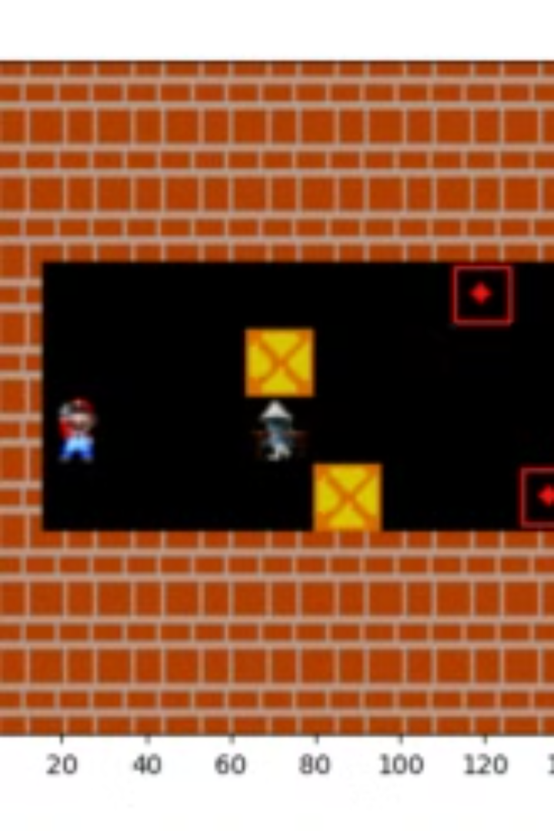

Final Project Report on Sokoban for Reinforcement Learning
This project explores the application of reinforcement learning (RL) to solve the Sokoban puzzle game. The report delves into the fundamental principles of RL, the chosen algorithm (SARSA), and the experimental results obtained..
lh
by le hoa

Slide 2

Theoretical Background
Reinforcement Learning (RL) involves an agent interacting with an environment to maximize cumulative rewards. Key components of RL include the agent, environment, state, action, reward, and policy. The agent learns to make decisions by interacting with the environment and receiving feedback in the form of rewards.

Slide 3
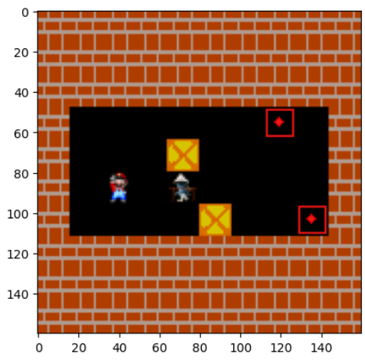


Slide 4

STATE OF ENVIRONMENT
A state is a description of the current situation in the game environment, including information about the positions of the boxes, the position of the player, and the positions of the objectives. Specifically, a state in a Sokoban environment can include:
Player position: The current square the player is standing on.
Box position: The position of each box on the board.
Target position: The position of the objective squares into which the box needs to be pushed

Slide 5
Overview of Algorithms
This project focuses on the SARSA algorithm, an on-policy, model-free RL algorithm. SARSA updates the Q-values based on the actions actually taken by the agent, encouraging exploration and learning robust strategies.
The update rule for SARSA is:
Q(s,a)←Q(s,a)+α[r+γQ(s′,a′)−Q(s,a)],
1
Q-Learning
2
Sarsa
3
Monte Carlo
Q-Learning is an off-policy algorithm that learns the value of action-reward pairs (Q-values) without requiring a model of the environment. The core update rule for Q-values is: Q(s,a)←Q(s,a)+α[r+γmaxa′Q(s′,a′)−Q(s,a)].
SARSA (State-Action-Reward-State-Action) is an on-policy algorithm that updates the Q-values based on the actions actually taken by the agent. The update rule differs from Q-Learning as it considers the next action chosen by the policy: Q(s,a)←Q(s,a)+α[r+γQ(s′,a′)−Q(s,a)].
Monte Carlo is a reinforcement learning algorithm that updates the Q-values based on the actual returns obtained from full episodes. Unlike temporal-difference methods, which update the Q-values step-by-step,. The Q-values are updated by averaging the returns across multiple episodes, and the update rule can be written as: Q(s,a)←Q(s,a)+α[Gt−Q(s,a)],

Slide 6
Problem Definition
The Sokoban problem is a grid-world environment where an agent (the player) pushes boxes to designated target locations (goals). The environment consists of a state space, action space, and reward structure. The state space represents the unique configurations of the grid, including the positions of the agent, boxes, traps, and goals..
Action
Description
Reward
Perform Step
Move the agent
-0.1
Push Box on Target
Push a box onto a target location
1.0
Push Box off Target
Push a box off a target location
-1.0
Push all boxes on targets
Complete the game by pushing all boxes onto targets
10.0
Move into Trap
Move the agent into a trap
-5.0
Push Box into Trap
Push a box into a trap
-10.0

Slide 7
Experimental Designs
The project utilizes the Sokoban environment, a popular setting in reinforcement learning. The hyperparameters used in this environment include the learning rate (α), discount factor (γ), exploration rate (ϵ), and number of episodes. The learning rate controls the step size for updating Q-values, the discount factor determines the importance of future rewards, the exploration rate balances exploration and exploitation, and the number of episodes defines the training duration.
Learning Rate (α)
Discount Factor (γ)
Exploration Rate (ϵ)
0.85
0.90
0.2, 0.5, 0.8

Slide 8
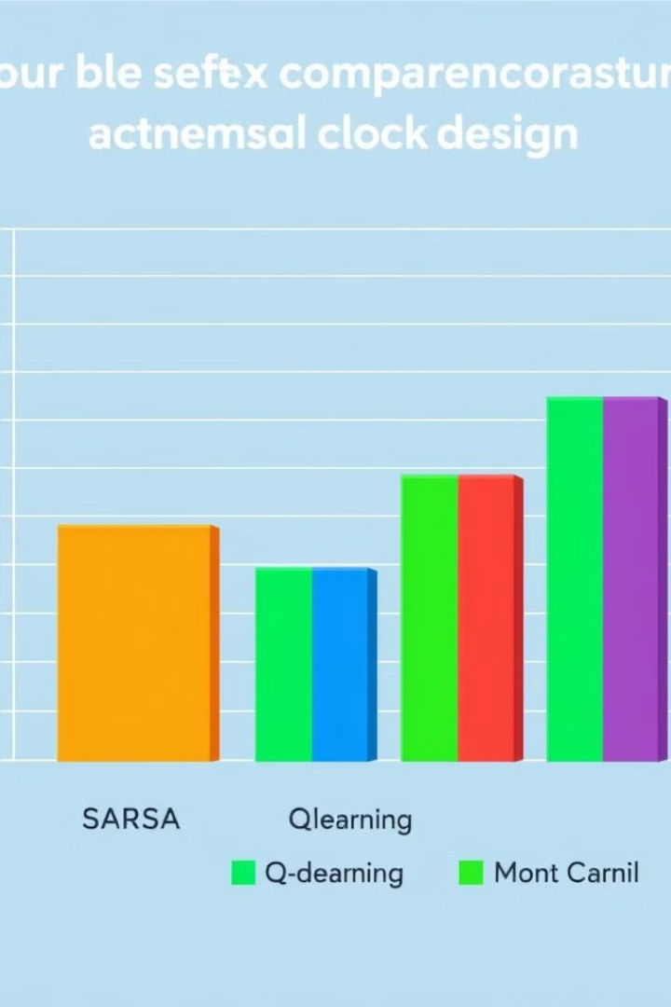



Results
The SARSA algorithm demonstrated faster convergence than Q-learning and Monte Carlo in the Sokoban environment. After running 5000 iterations, the average reward of the SARSA algorithm reached 10.98,
. This indicates that SARSA was more effective in finding optimal policies and achieving higher rewards in this specific environment.
SARSA
Average Reward: 10.98
Q-Learning
Average Reward: 2.73
Monte Carlo
Average Reward: 0.23

Slide 9
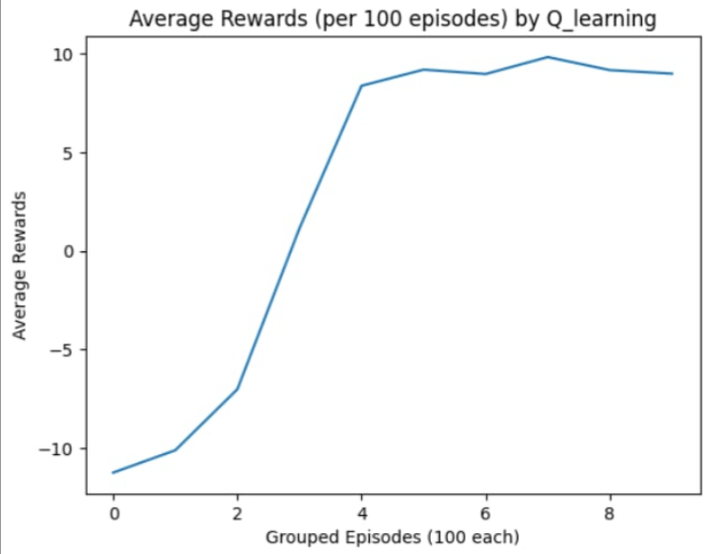
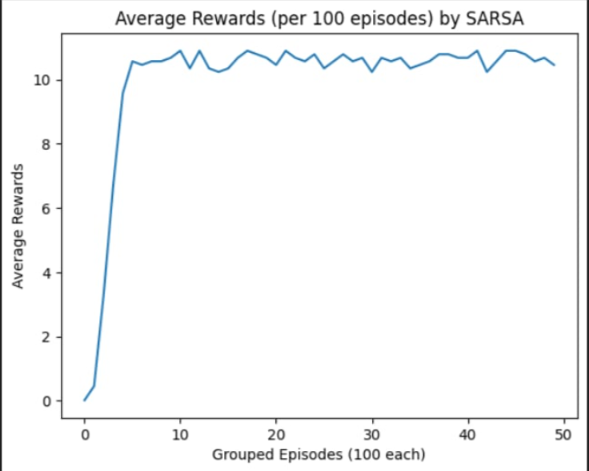
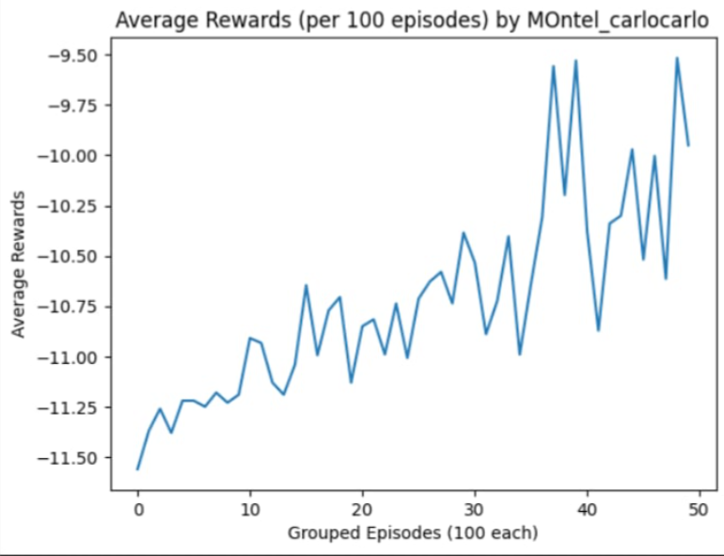
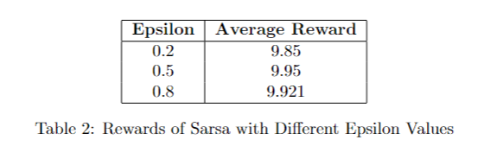
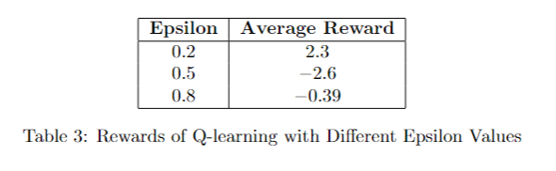


Slide 10
Challenge
The project explored adding a feature to reward the agent for approaching the box as quickly as possible. This was intended to accelerate the learning process by encouraging the agent to prioritize reaching the box.
However, the experimental results showed that this feature did not significantly improve performance. Training was relatively slow, and after 5000 epochs, the agent only achieved an average reward of 0.82.
Reward for Proximity
Performance Impact
Average Reward
The agent received a reward of +1 for approaching the box.
The added reward did not significantly improve performance.
The agent achieved an average reward of 0.82 after 5000 epochs.

Slide 11




Conclusion
The project compared the performance of traditional reinforcement learning algorithms, such as SARSA, Q-learning, and Monte Carlo, in the Sokoban environment.
they may still have potential in different or less complex environments. The project also emphasizes the importance of carefully designing the reward structure to impact the agent's learning efficiency and final performance.
SARSA
Outperforms other algorithms in stability and convergence speed.
Reward Structure
Crucial for learning efficiency and performance.
Future Work
Explore deep reinforcement learning methods and dynamic environments.

